Slide 1
Making JavaScript WARC
David Calano
CS 895 - Web Archiving Forensics
Week 5
September 26, 2022
Fall 2022
CS 895: Web Archiving Forensics
Notes:
https://goelayu.github.io/
https://github.com/goelayu/Jawa
https://www.usenix.org/system/files/osdi22-goel.pdf
https://www.usenix.org/sites/default/files/conference/protected-files/osdi22_slides_goel.pdf
https://goelayu.github.io/files/jawa-poster.pdf

Slide 2
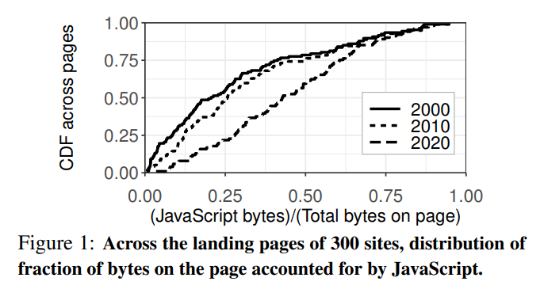
Invasion of the Byte Snatchers!
Median of 44% bytes devoted to JS (2020)
4x increase in JavaScript utilization
Trend towards complexity
Significant portion of JavaScript is irrelevant to web archiving
https://www.usenix.org/system/files/osdi22-goel.pdf
Fall 2022
CS 895: Web Archiving Forensics
Notes:
Goel et al. have measured that the median allotment of JavaScript in 2020 was 44% of total page bytes, up 24% from the year 2000.
Web pages have seen a four-fold increase in JavaScript adoption since 2010, growing in complexity each year.

Slide 3
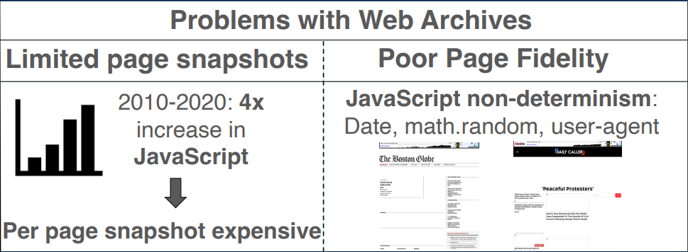
What’s the Problem?
https://goelayu.github.io/files/jawa-poster.pdf
Fall 2022
CS 895: Web Archiving Forensics
Notes:
Storage overhead increasing.
Web archiving is a simple task for static pages without JavaScript or complex interactions.
JavaScript enables dynamic interaction and asynchronous loading of resources which make complete resource extraction and crawling difficult for traditional archiving methods.
A client’s device, browser, location, among other variables can all have an effect on how a page is represented to a user.
Many code analysis methods are too computationally expensive to be efficiently utilized when crawling.

Slide 4
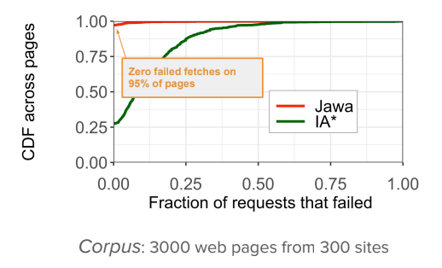
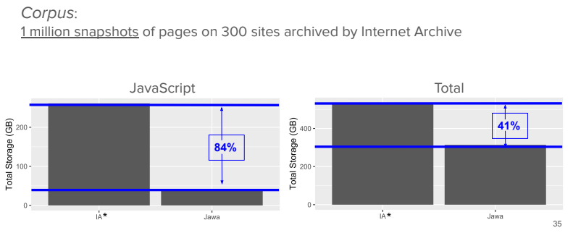
What Can a “JavaScript-Aware Web Archive” Do For You?
Lower storage and data costs
Reduced overhead
Increased archival capacity
Future proofing
Increased visual fidelity
https://www.usenix.org/sites/default/files/conference/protected-files/osdi22_slides_goel.pdf
Fall 2022
CS 895: Web Archiving Forensics
Notes:
Jawa can help optimize operational costs and capacity for traditional archives
Enables a thinner line between live and archived web.
Jawa almost eliminates failed resource requests eliminating a huge problem with current web archives.
As an:
End User: Increased fidelity for requested snapshots
Archivist: Better storage efficiency, future proofing, and user satisfaction

Slide 5
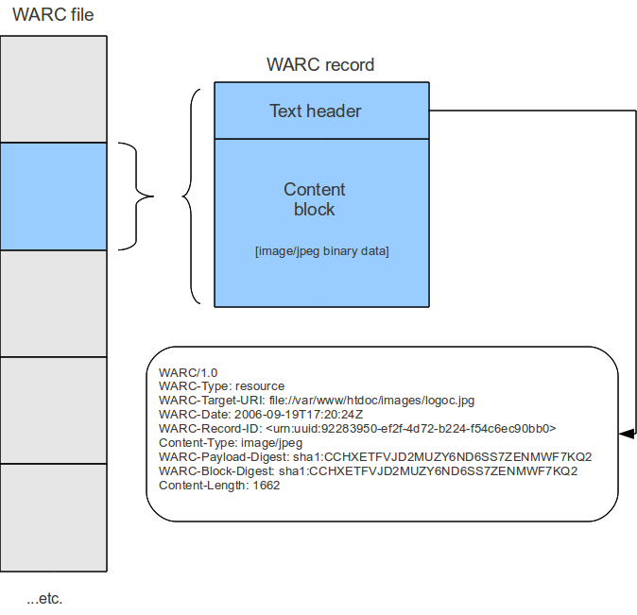
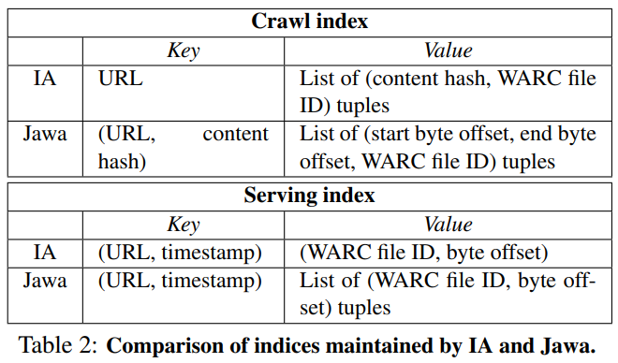
WARC
vs
Jawa
WARC
Stores deduplicated files for each page snapshot
File URLs rewritten
Deterministic content extraction
https://wiki.archivematica.org/Significant_characteristics_of_websites
Jawa
JavaScript stored in partitioned byte offsets
JavaScript served from compiled partitions
Index I/O efficiency improvements
Non-deterministic content extraction
https://www.usenix.org/system/files/osdi22-goel.pdf
Fall 2022
CS 895: Web Archiving Forensics
Notes:
Jawa still using WARC files for archived indices.
Jawa files store JavaScript as partitioned chunks of code within the archive.
When a snapshot is requested the relevant JavaScript partitions are read at various byte offsets and compiled back together.
1 to 5 reduction in I/O requests when serving compared to IA indexes.

Slide 6
Datasets
Corpus_{3K}
300 random websites sampled across 3 Alexa top site rank stratifications
Single snapshot selected from Sept. 2021
1 landing page, 9 internal pages
Corpus_{1M}
3,500 snapshots for each Internet Archive page selected from Sep. 2020
Fall 2022
CS 895: Web Archiving Forensics
Notes:
Alexa top site groupings:
1 - 1,000
1,000 - 100K
100K - 1M
While snapshots were chosen from a specifically dated page, page contents of each snapshot could be much older.
Pages outside of the collected dataset might exhibit patterns and edge cased not handled by Jawa’s techniques.

Slide 7
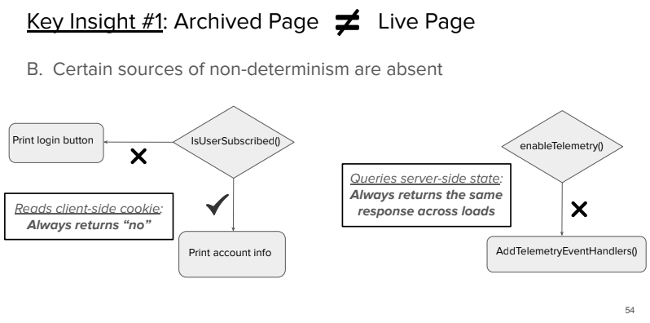
The Past and Present Web
https://www.usenix.org/sites/default/files/conference/protected-files/osdi22_slides_goel.pdf
Fall 2022
CS 895: Web Archiving Forensics
Notes:
Examination of key differences between live and archived web in relation to interactivity and non-determinism.
Any server-side communication API would not be operational within the context of a web archive.
Public archives viewed through a context-less lens, state configurations are more-or-less not an option for web archives.
Both client-side and server-side interactions act as sources of non-determinism.

Slide 8
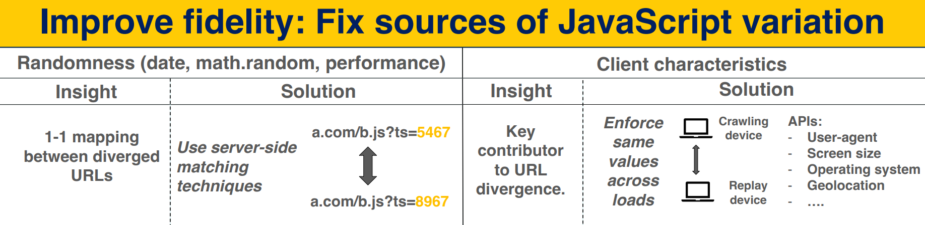
Client-side Variance
https://goelayu.github.io/files/jawa-poster.pdf
Fall 2022
CS 895: Web Archiving Forensics
Notes:
Date, Random, Performance (dubbed DRP) APIs had no ultimate performance impacts but did need to be accounted for in crawling requests
A large source of snapshot fidelity issues stem from dynamic inputs to page APIs which can affect what representation is returned to the user and even the number of files returned by a server.
Jawa’s crawler measures impact of non-determinism by loading two different clients, a desktop and iPhone 6, to analyze how a page changes across different client devices.

Slide 9
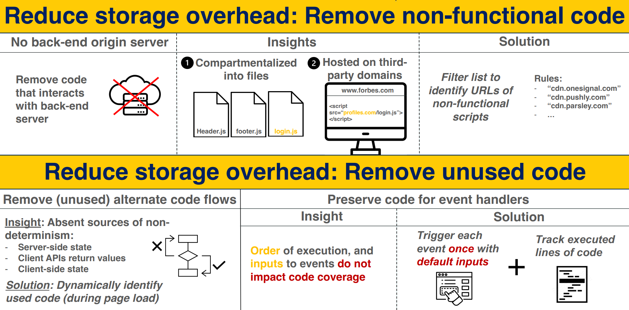
Prune the Trees, Not the Forest
https://goelayu.github.io/files/jawa-poster.pdf
Fall 2022
CS 895: Web Archiving Forensics
Notes:
Curated filter list based on manual assessment.
Blocking of requests to common third-party libraries and code which categorically would not work with web archives.
With file compartmentalization and importing third-party libraries being common practices within software development, file-level blocking and remote script calls are relatively lightweight and powerful techniques.
Jawa analyzes code by converting JavaScript into an Abstract Syntax Tree (AST) to then evaluate scope and variable information.
Activation of all event triggers to see which code can be kept and which code would never be executed and could therefore safely be pruned.

Slide 10
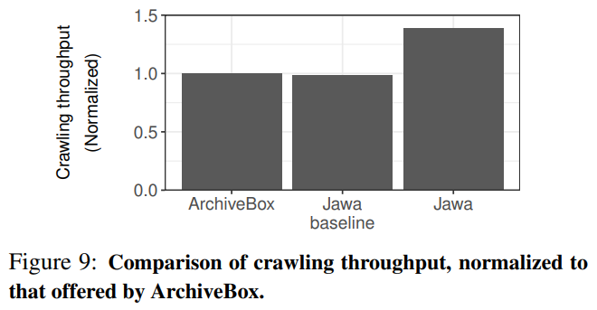
Testing
ArchiveBox used as basis for testing
Proprietary Internet Archive code and headless Chrome engine
Custom crawler to inject blocking and code analysis capabilities
Decreased I/O calls due to filtering
No performance impact from DRP APIs
https://www.usenix.org/system/files/osdi22-goel.pdf
Fall 2022
CS 895: Web Archiving Forensics
Notes:
Cannot test directly against Internet Archive’s infrastructure as their crawler is partly proprietary and they use a customized headless Chrome implementation.
Jawa and ArchiveBox have similar baseline performance.
Much of Jawa’s crawler performance gains over ArchiveBox comes from it’s filtering, which could be implemented into software like ArchiveBox.
Filtering reduces overall I/O reads when crawling by both blocking requests to third-party scripts as well as subsequent requests that would have been made by them.

Slide 11
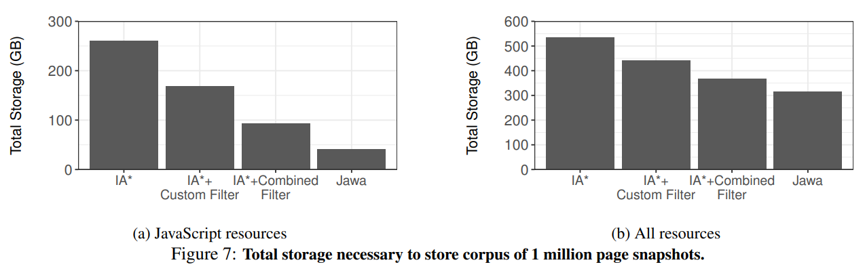
Code Reduction
https://www.usenix.org/system/files/osdi22-goel.pdf
Fall 2022
CS 895: Web Archiving Forensics
Notes:
Storage requirements:
Internet Archive base crawling techniques
IA crawl + blocking applied from Jawa’s custom filter
IA Crawl + Jawa filter + EasyList Ad blocking filter
Jawa crawl techniques
Highlighting of large amount of JavaScript code that is not compatible with or necessary for archives snapshots
Ads
Forms, inputs
Commenting, tweeting, sharing, and similar social media interactions

Slide 12

Pros and Cons
Amazing promise
Great presentation and ephemera
Modular design
Large sampling
Reproducible results
Open code and data
Adoption
Integration
Small sampling
No improvements with regard to assets
Static filter list
Shifting landscape
Link rot on project page
Fall 2022
CS 895: Web Archiving Forensics
Notes:
The Jawa project’s homepage presents multiple pieces of quality ephemera such as a presentation video, related presentation slides, a project overview poster, and the open source code repository.
Jawa is written in such a way that it can easily be used in a piecewise manner, adaptable to the needs and capabilities of a given archivist.
Reasonable sampling pools.
Project makes efforts to promote reproducible data and results, which is a large issue in scientific research and experimentation.
—
A large hurdle for Jawa, as with anything new, is reaching a critical mass of large-scale social adoption
Integration is the largest elephant in the room
Labor, time, cost
Redesigns
Technical hurdles
The true size and scope of the world wide web is difficult ascertain, is this sample size truly representative enough when measuring the web is difficult to begin with?
The technological landscape shifts so rapidly that the authors’ predictions on future proofing could eventually have to be reworked.
Broken links are like the floor-legos of the web, which was a little ironic to find on a project about web archiving. The slides link on the project’s main page is currently broken as the OSDI presentation has moved the page which was hosting the project’s presentation slides.
Project’s link: https://www.usenix.org/system/files/osdi22-goel-slides.pd
Current link: https://www.usenix.org/conference/osdi22/presentation/goel

Slide 13
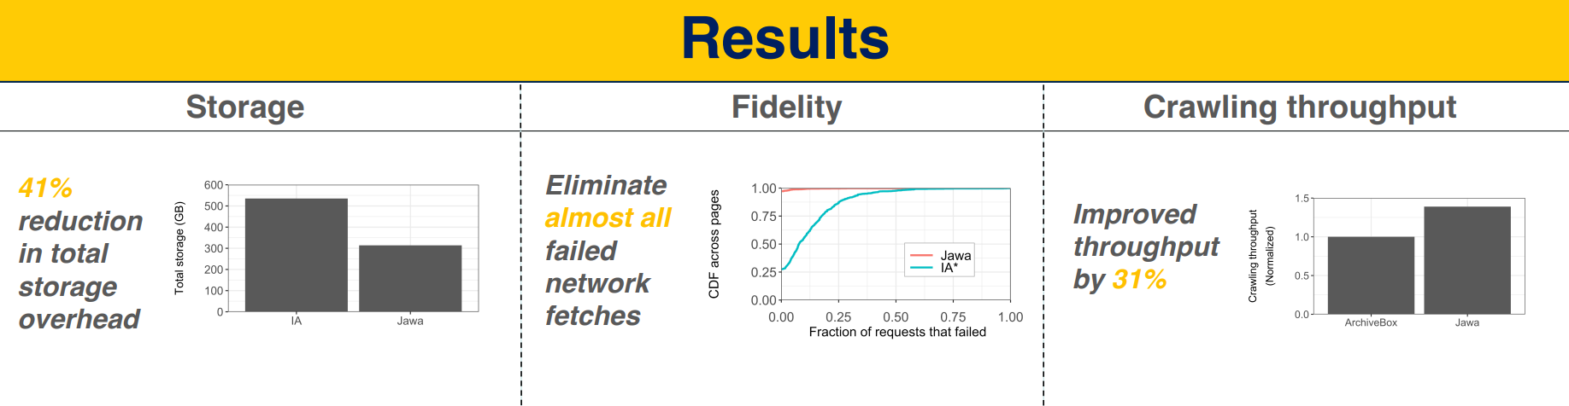
Takeaways
JavaScript must ultimately be addressed in web archives
Largest issues related to non-deterministic nature
Non-breaking improvements can presently be implemented
Huge potential for cost and overhead savings
https://goelayu.github.io/files/jawa-poster.pdf
Fall 2022
CS 895: Web Archiving Forensics
Notes:
With JavaScript existing as such a prevalent force within the Web’s infrastructure and its use only growing, I agree with the authors in that JavaScript must become some incorporated part of a web archive index.
Not all archives might have the resources or ability to adapt an entirely new format. Jawa’s design allows archives to capitalize on it’s research and tools to implement improvements without having to complete migrate to a new archive format. Archives can utilize Jawa’s filter list to prune unnecessary code.
Authors calculate that using Jawa’s filtering techniques, the Internet Archive would only have to test 1 in 53 crawls to ensure content fidelity, which could be toggled off for future crawls of a website that is experiencing issues.
Jawa offers huge potential savings for large archives with its ability to significantly reduce archived JavaScript code through lightweight mechanisms. This directly translates to large cost savings and increased storage capacity. With respect to the Internet Archive, the authors estimate a data savings to the tune of 35 petabytes.

